Slide 1
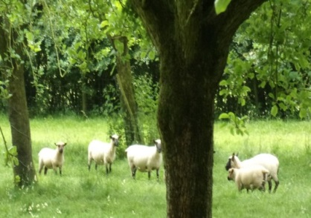
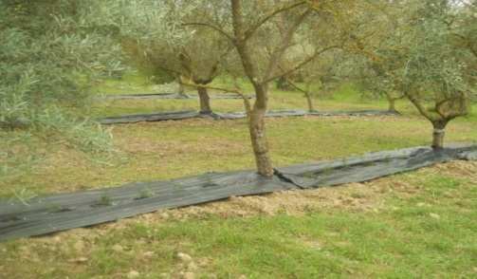
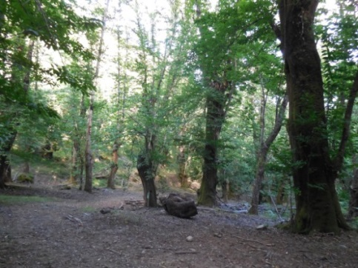
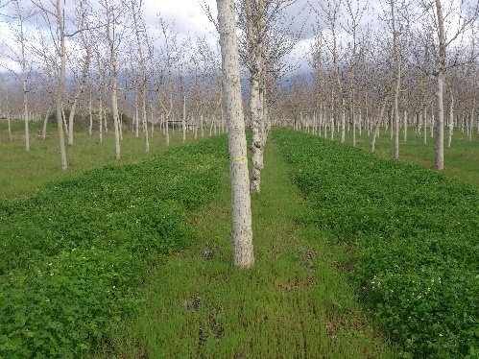
Agroforestry for High Value Trees: Synthesis of System Descriptions
Anastasia Pantera, Paul J Burgess, Nathalie Corroyer, Nuria Ferreiro-Domínguez, Juan Luis Fernández Lorenzo, Pilar González-Hernández, Anil Graves, Jim McAdam, Gerardo Moreno, Rosa Mosquera Losada, Antonio Rigueiro Rodríguez, Adolfo Rosati, Philippe Van Lerberghe
30 March2017
European Union’s Seventh Framework Program for research, technological development and demonstration under grant agreement no 613520

Slide 2
Aims of the study
Descriptions of High Value Trees…
Objective 1: Description of components
Objective 2: Description of the structure
Objective 3: Description of ecosystem services
Objective 4: Description of economic value
…selected systems

Slide 3
Methodology
During 2014, each partner established a stakeholder group including farmers and other groups of interest, which highlighted key challenges for a range of agroforestry practices.
Each group -identified potential innovations.
This report synthesizes the planned activities to test and develop.
Full details of the individual protocols are available on the AGFORWARD website

Slide 4
Components of selected systems

Slide 5
Structure of Grazed High Value Tree Systems: Apple orchards
System | Country | Strata | Spatial arrangements | Temporal arrangement | Tree spacing | Tree height | Tree density | Stocking density
Grazed orchards | UK | 2 V | Traditional orchard with trees in rows | Sheep are removed 56 days before apple harvest | 6 m x 3 m | 6-7 m | 500 ha⁻¹ | 20 sheep ha⁻¹
 | NI (UK) | 2 V | Bush orchards in linear rows with windbreaks | Short-term grazing on small plots; sheep start in May, removed in June, and introduced in Nov – Dec | Cider variety 5 m x 2 m Dessert variety 4 m x 1.5 m | 2-2.5 m | Cider: 900 ha⁻¹ Dessert: 1485 ha⁻¹ | Over the season 12-15 sheep ha⁻¹
 | France | 2 V | Bush orchards in linear rows | Sheep introducing in April & removed in mid-November | 5-5.5 m x 2-2.5 m | 5 m | 600-1000 ha⁻¹ | 4 sheep ha⁻¹

Slide 6
Structure of Grazed High Value Tree Systems: Ash and Walnut
System | Country | Strata | Spatial arrangements | Temporal arrangement | Tree spacing | Tree height | Tree density | Stocking density
Traditional wood pasture | France | Multiple H & V | Boundary (Hedges around fields) | Sheep introduced in April - November | no specific | ±18 m | 60-70 ha⁻¹ | Not specified
Grazed walnut | Spain | 2V | Linear rows of trees | Year-round grazing except the lambing period | 6 m x 5 m | ~ 12 m | 333 ha⁻¹ | 1

Slide 7
Structure of Grazed High Value Tree Systems: Chestnut and orange groves
System | Country | Strata | Spatial arrangements | Temporal arrangement | Tree spacing | Tree height | Tree density | Stocking density
Chestnut agroforestry | Spain | 2H and 1V | Scattered trees with full canopy cover | April- December | No specific | na | - | 1.5
 |  |  |  | Whole year around | - | - | - | -
 |  | 2H
 |  |  |  |  |  |  |  | -
Intercropped orange groves | Greece | 2 V | Scattered and in some cases linear rows of trees | Intercropping only in spring-early summer | 10 m x 10 m | ~ 5 m | 100 ha⁻¹ | -

Slide 8
Structure of High Value Tree Systems: Olive orchards
System | Country | Strata | Spatial arrangements | Temporal arrangement | Tree spacing | Tree height | Tree density | Stocking density
Intercropping of olive groves | Greece | 2 V | Linear rows of trees and in-between intercrops | Intercropping only in spring-summer, sheep from March to November* | 10 m x 10 m | ~ 5 m | 120 ha⁻¹ | Not specified
 |  | 2 V | Scattered and in some cases linear rows of trees | Intercropping only in spring-summer, sheep & goat grazing from March- November* | 10 m x 10 m | ~ 8 m | 100 ha⁻¹ | -
 | Italy | 2 V and 1 H | Intercrops between linear rows of olive trees: traditional spacing | Intercropping with permanent evergreen (asparagus) or with fall-to-spring vegetation (bulbs) crops | 5 m x 4 m | 5 m | 500 ha⁻¹
 |  |  | Super-high density |  | 4 m x 1.5 m | 2.5 m | 1666 ha⁻¹

Slide 9
ES of Grazed High Value Tree Systems: Apple orchards
 |  | Provisioning |  |  |  | Regulating |  |  |  |  | Cultural
System | Country | Food | Fuel wood | Timber | Artifacts from olive wood | Shelter or shade for animals | Microclimate for crops | Disease regulation | Water purification | Carbon storage | Traditional cultural heritage | Recreation | Aesthetic | Education | Employment opportunity | Inspiration
Grazed orchard | UK | Apple, cider, meat | ✓ |  |  | ✓ |  | ? |  | ✓ | ✓ |  | ✓ | ✓ | ✓
 |  | Apples, cider, meat | ✓ |  |  | ✓ |  | ? |  | ✓ | ✓ |  | ✓ | ✓ | ✓
 | France | Apple, cider, meat, dairy products | ✓ |  |  | ✓ |  | ? |  | ✓ | ✓ |  | ✓ | ✓ | ✓

Slide 10
ES of Grazed High Value Tree Systems : Ash and Walnut
 |  | Provisioning |  |  |  | Regulating |  |  |  |  | Cultural
System | Country | Food | Fuel wood | Timber | Artifacts from olive wood | Shelter or shade for animals | Microclimate for crops | Disease regulation | Water purification | Carbon storage | Traditional cultural heritage | Recreation | Aesthetic | Education | Employment opportunity | Inspiration
Traditional wood pasture | France | Meat, dairy products | ✓ |  |  | ✓ |  |  | ✓ | ✓ | ✓ |  | ✓ | ✓ | ✓
Grazing walnut | Spain | walnuts, meat, dairy products | ✓ |  |  | ✓ |  | ✓ | ✓ | ✓ | ✓ |  | ✓ | ✓ | ✓

Slide 11
ES of High Value Tree Systems : Chestnut and orange groves
 | Country | Provisioning |  |  |  | Regulating |  |  |  |  | Cultural
System |  | Food | Fuel wood | Timber | Artifacts from olive wood | Shelter or shade for animals | Microclimate for crops | Disease regulation | Water purification | Carbon storage | Traditional cultural heritage | Recreation | Aesthetic | Education | Employment opportunity | Inspiration
Intercropping of oranges | Greece | oranges, herbs, poultry | ✓ |  |  |  | ✓ | ✓ | ✓ | ✓ | ✓ | ✓ | ✓ | ✓ | ✓ | ✓
Chestnut agroforestry in Galicia | Spain | chestnuts, meat, dairy products | ✓ | ✓ |  | ✓ |  | ✓ | ✓ | ✓ | ✓ | ✓ | ✓ | ✓ | ✓ | ✓
 |  | chestnuts, mushrooms | ✓ | ✓ |  |  | ✓ |  | ✓ | ✓ | ✓ | ✓ | ✓ | ✓ | ✓ | ✓

Slide 12
ES of High Value Tree Systems : Olive trees
 | Country | Provisioning |  |  |  | Regulating |  |  |  |  | Cultural
Intercropping of olive groves | Greece | olives, olive oil, herbs, vegetables, meat, dairy product | ✓ |  | ✓ |  |  |  |  | ✓ | ✓ | ✓ | ✓ | ✓ | ✓ | ✓
 |  | olives, olive oil, vegetables, meat, dairy | ✓ |  | ✓ |  |  |  | ✓ | ✓ | ✓ | ✓ | ✓ | ✓ | ✓ | ✓
 | Italy | olives, olive oil, asparagus, flowers | ✓ |  | ✓ |  | ✓ |  | ✓ | ✓ | ✓ | ✓ | ✓ | ✓ | ✓ | ✓

Slide 13
Economic value of Grazed High Value Tree agroforestry systems: Apple orchards
System | Country | Labour | Mechanization level | Inputs | Outputs | Goal
Grazed orchard | UK | High: Sheep may reduce mowing costs; but labour needed to manage sheep | Medium; Mowing can be reduced by use of sheep | Case study system does not use fungicide for scab control | 12-50 t/year/ha apple) About 20 ewes per hectare with 2 lambs produced per ewe | C
 |  | High (mowing, spraying, pruning, harvesting, sheep herding) | High: mowing for grass and chemicals for pest control | High use of pesticides | 30-45 t ha⁻¹ apple | C
 | France | High (mowing, spraying, pruning, harvesting, sheep herding) | High: mowing for grass and chemicals for pest control | Low in pesticides & fertilizers (cattle manure), reduced mowing | 25-35 t/year apple | C

Slide 14
Economic value of Grazed High Value Tree agroforestry systems: Ash, Walnut and Orange
System | Country | Labour | Mechanization level | Inputs | Outputs | Goal
Pollarded boundary | France | Low (pollarding, sheep herding) | Low (tree pollarding) | Low | Medium (cheese) | S – I
Orange groves | Greece | High (pruning, spraying, cultivation & planting, harvesting) | High: pruning, cultivation for intercrops and chemicals for pest control | High (pesticides, N fertilisation) | Orange production approx. 25 t/ha, chickpeas: 2 t/ha | C & S
Grazed walnut timber plantations | Spain | High (pruning, harvesting, sheep herding) | Low: fertilization | Low (fertilizers) | High (timber, meat and cheese) | C

Slide 15
Economic value of High Value Tree agroforestry systems: Chestnut and Walnut
System | Country | Labour | Mechanization level | Inputs | Outputs | Goal
Chestnut | Spain | Low | none | none | High | C
 |  | Low | none | none | 0.2 t ha⁻¹ mushroom production | C
Walnut timber plantations | Spain | High (ploughing, spraying, pruning, harvesting) | High: mowing for grass, chemicals for pest control, fertilization | High (energy, pesticides & fertilizers) | High (timber) | C

Slide 16
Economic value of High Value Tree agroforestry systems: Olives
System | Country | Labour | Mechanization level | Inputs | Outputs | Goal
Inter-cropping of olive groves | Greece | High (pruning, spraying, ploughing, cultivation & planting, harvesting, sheep herding) | High: pruning, cultivation for intercrops and chemicals for pest control | Low (chemicals –Cu-for olive pests once a year, N fertilisation) | Olive production approx. 2.3 t/ha, chickpeas: 2 t/ha oregano: 0.97-1.8 t/ha | C & S
 |  | High (pruning, spraying, ploughing, cultivation & planting, harvesting,) | High: pruning, cultivation for intercrops and chemicals for pest control | High (pesticides, N fertilisation) | Olive production approx. 2.3 t/ha, chickpeas: 2 t/ha | C & S
 | Italy | High (pruning, spraying, cultivation & planting, harvesting) | High: harvesting, cultivation for intercrops and chemicals for pest control | Medium (N P K fertilisation + pest control (Peacock eye disease and olive fly) | Olive production approx. 6-12 t/ha, asparagus 0.5 t/ha | C & S

Slide 17
High Value Tree AFS….
include apple, olives, chestnut, walnut, orange as the tree species,
grass is the most common crop component but also vegetables and flowers,
sheep is the most common livestock species but also pigs,
they have mostly a two layer structure in linear rows, coincident, intermittent or concomitant in time throughout the year production
they provide numerous ecosystem services
labour depends on the intensity and the mechanization of the system
they are mostly for commercial use

Slide 18
Conclusions
High Value Tree Agroforestry systems are characterised by
numerous ecological and economical advantages
the use of valuable tree species that are mainly intercropped by grass and other agricultural species and/or with livestock, mainly sheep
providing a promising intensive land management system with a wide range of goods
promoting agroforestry practices in Europe that will advance sustainable rural development

Slide 19
European Union’s Seventh Framework Program for research, technological development and demonstration under grant agreement no 613520
www.agforward.eu

