Slide 1
WP3 Production of chestnut grafts for new plantations
Fernández-Lorenzo JL, Rigueiro-Rodríguez A, Ferreiro-Domínguez N, Mosquera-Losada MR
29 April 2017
European Union’s Seventh Framework Program for research, technological development and demonstration under grant agreement no 613520

Slide 2
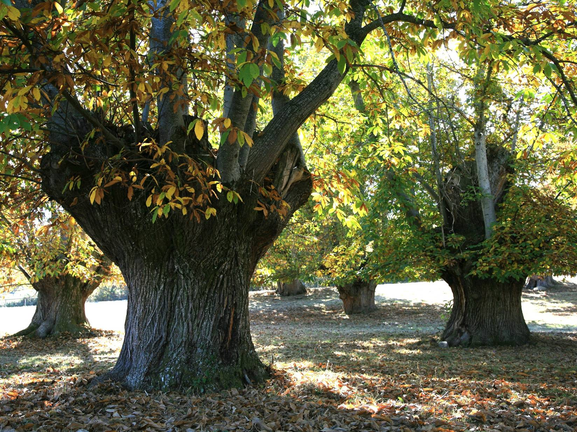
Background
In Galicia, some agroforestry systems are traditionally exemplified by chestnut production in ‘Soutos’. Galician varieties are recognized under a Protected Geographical Indication.
Grafted plants of selected varieties are highly demanded by chestnut growers, but these plants are scarce due to the long time needed to obtain them.
As well, there is a lack of knowlegde about which hybrid rootstocks resistant to ink disease would be more suitable for each variety.

Slide 3
Objective
To develop methods to mass-produce grafted and self-rooted plants
of Galician Castanea sativa varieties selected for fruit quality, and to
test them in the field

Slide 4
Materials and Methods Plant material
Explants/scions of 4 selected varieties of chestnut (Castanea sativa) trees, obtained from forced branch segments.
Plantlets of 4 clones of hybrid chestnut (Castanea sativa x C. crenata), resistant to ink disease, rooted in vitro, to be used as rootstocks for in vitro grafting.
Seedlings of C. sativa germinated in growth chamber, to be used as rootstocks for in vivo grafting.
Varieties | Hybrid rootstocks
Parede Negral Longal Loura | 7521 111 3 7810

Slide 5
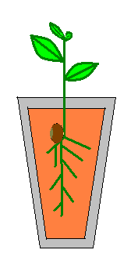
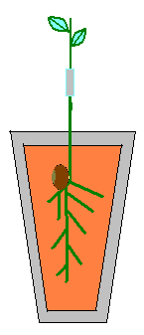
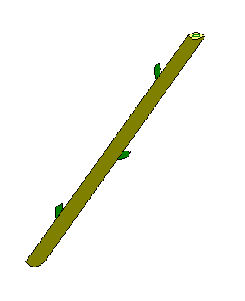
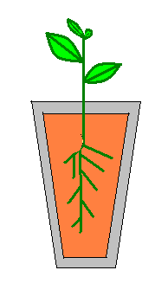
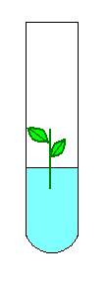
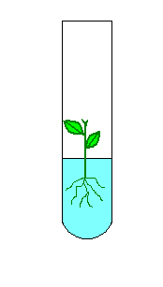
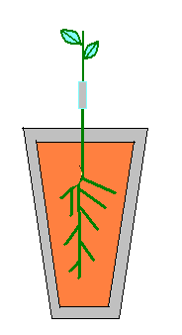
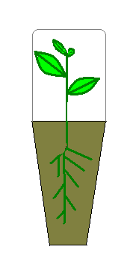
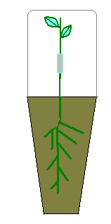
Materials and Methods Experimental system: production of plants
Seedlings
In vivo grafting
Scion
Variety
Tests in the field
Tests of compatibility:
In vitro grafting on unrooted rootstocks
Scion
Self-rooting
In vitro grafting
Grafting procedure
Miniaturized cleft-grafting
Elongated scions from grafts yield new portions to be regrafted on new rootstocks, in a cyclic process.
Hybrid

Slide 6
Materials and Methods Experimental system: Tests in the field
2 sites in Galicia
Zone II (Interior North; medium to high risk of ink disease)
Zone IV (Eastern Mountains; low risk)
24 possible combinations to be tested
Zone II: 16 possible combinations of variety grafted on hybrid
Zone IV: 4 possible combinations of variety grafted on seedling and 4 possible self-rooted varieties
3 blocks per combination
36 plants per block
16 central plants to be tested
x | x | x | x | x | x
x | x | x | x | x | x
x | x | x | x | x | x
x | x | x | x | x | x
x | x | x | x | x | x
x | x | x | x | x | x
2 m

Slide 7
Results In vitro grafting compatibility (first results)
ROOTSTOCK (SCION: Loura) | % Graft take (2 months)
111 | 70.83 b
7521 | 70.83 b
3 | 40.97 c
LOURA | 87.50 a
p<0.01; LSD-test

Slide 8
Results Self-rooting (in vitro): Loura, Parede
% Rooting
Plants of Loura and Parede are acclimatized and ready to be established in the field
Other varieties still to be tested
No significant differences

Slide 9
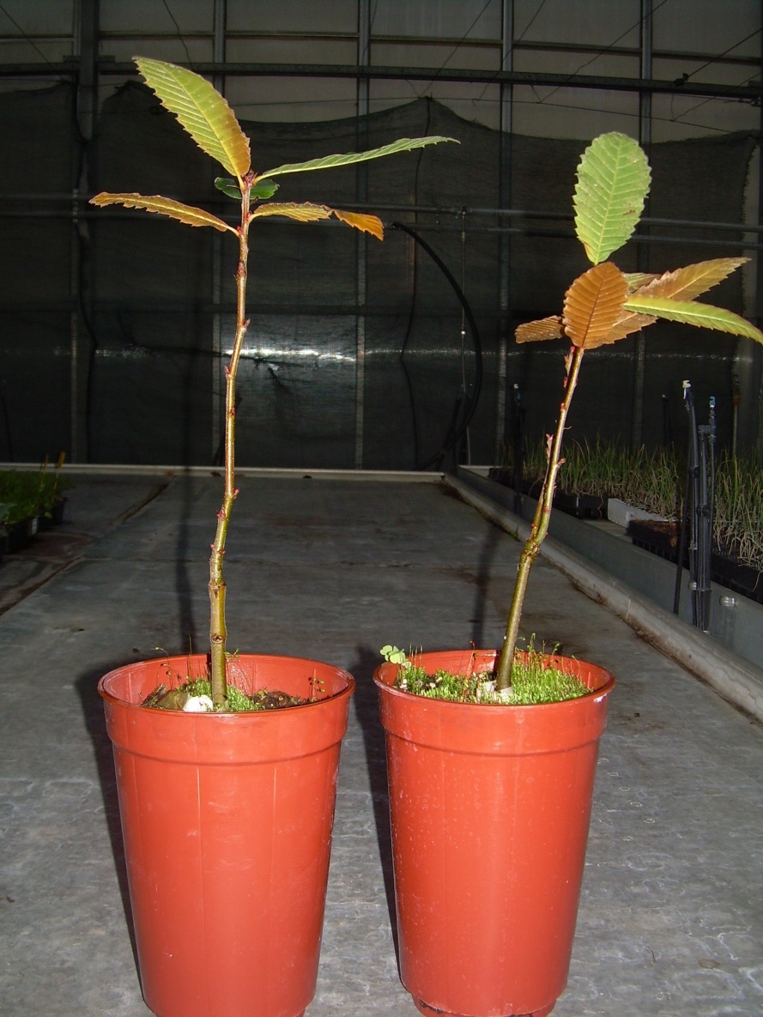
Results Grafting success on seedlings
LOURA: 46.3 %
PAREDE: 52.3%
Graft union takes place 15-20 days after grafting. If graft fails, it is possible to regraft quickly
Grafts of Loura and Parede on seedlings ready to be established in the field
Other varieties still to be tested

Slide 10
Results % Rooting of hybrids in vitro
Hybrid | Agar medium | Perlite | Perlite:Peat-moss (1:1)
111 | 48.44 bB | 91.1 aA | -
3 | 45.31 bB | 79.2 bA | 46.1 bB
7521 | 20.31 cB | 88.9 aA | 29.1cB
7810 | 95.83 aA | 68.8 cB | 100 aB
Treatment by dipping in 1.0 mg/L IBA for 2 min; Small letters show significant differences in columns and caputal letters in files.
Rooted hybrid clones are currently been assayed in grafting experiments

Slide 11
Conclusions
Varieties already stabilized (Loura and Parede) rooted well and produced plants suitable to be established in the field. Varieties newly introduced (Negral, Longal) are needing a long a time to be stabilized in vitro and used as scions or as self-rooted material (additionally, problems with mite infestation of cultures delayed the process).
In vivo micrografting on seedlings yielded aceptable results in the varieties tested (Loura/Parede) in terms of grafting success and rapidity of production. Micrografted plants are been established in the field.
Micrografting on hybrids (without roots) tested for compatibility in vitro with the variety Loura shows that there are differences between hybrids in terms of suitability for grafting (111 and 7521 are better than 3).
A suitable method for rooting of hybrids has been established; in vitro grafting on rooted hybrids are carried out in this moment with varieties Loura and Parede. The establishment in the field should be in autumn 2017.

Slide 12
European Union’s Seventh Framework Program for research, technological development and demonstration under grant agreement no 613520
www.agforward.eu

