Slide 1

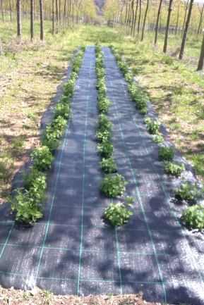
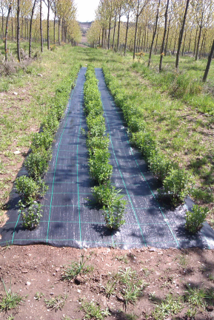
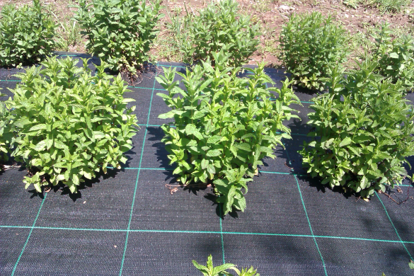
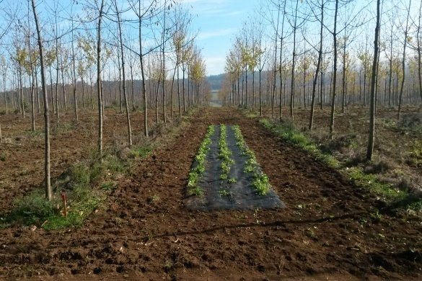
Melissa officinalis L. under cherry tree in Galicia, Spain
Mosquera-Losada MR, Ferreiro-Domínguez N, Romero Franco, Rigueiro-Rodríguez A
27 April 2017
European Union’s Seventh Framework Program for research, technological
development and demonstration under grant agreement no 613520

Slide 2
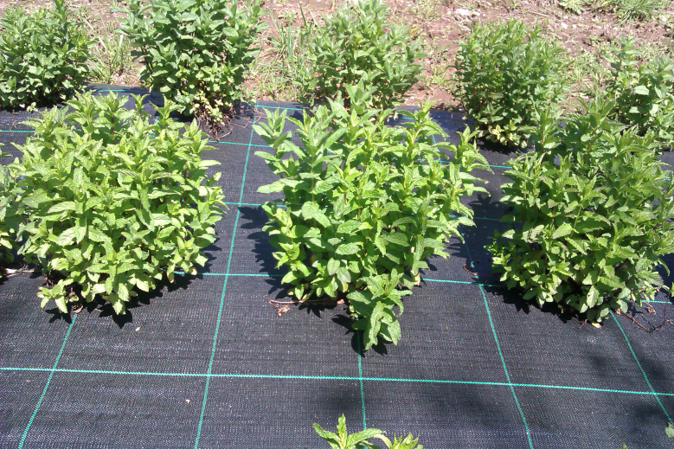
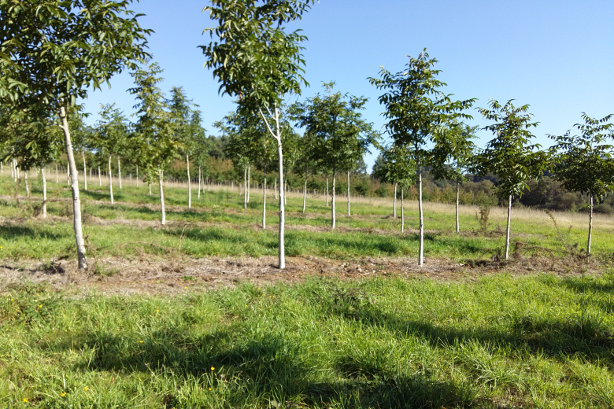

Background
Medicinal plants
INTERCROPPED
Prunus avium L.
Medicinal plants
About 80% of the people in the world use medicinal plants
In the tropics, many medicinal plants are well adapted to partial shading
Prunus avium L.
High value timber cherry trees have low radiation interception for the understory compared with more extended used tree species in Galicia region
Fast growth rate with better financial returns (3000 € m⁻³)
Agroforestry has ECONOMIC, ENVIRONMENTAL and SOCIAL advantages compared with exclusively agronomic and forestry land use

Slide 3
Objective
  To evaluate the effect of the tree density and fertilisation on medicinal plant production and the concentration of active principles of Melissa officinalis L. established under Prunus avium L. in Galicia, NW Spain

Slide 4

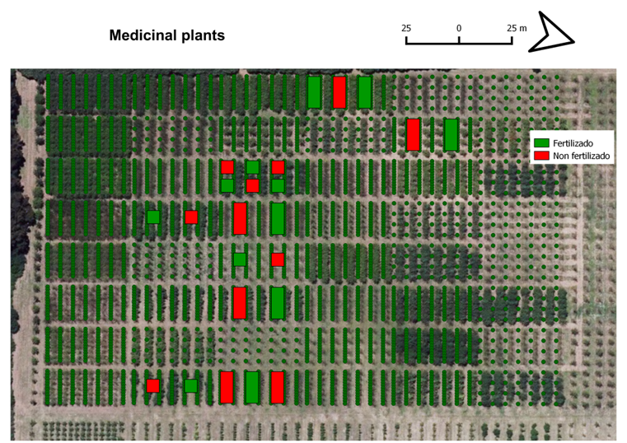
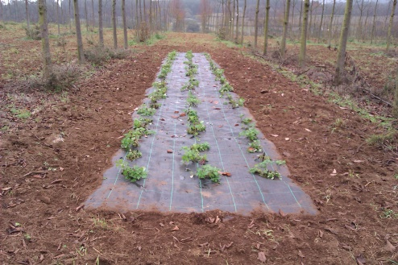
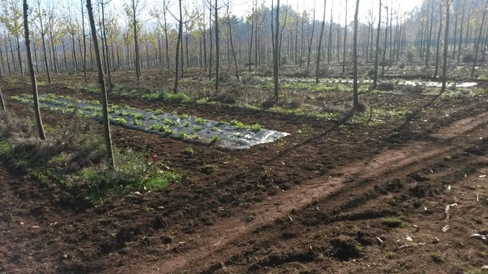
Materials and Methods
LOCALISATION
TREATMENTS
333 trees ha⁻¹ without fertiliser
333 trees ha⁻¹ + sheep manure (5 t ha⁻¹)
1333 trees ha⁻¹ without fertiliser
1333 trees ha⁻¹ + sheep manure (5 t ha⁻¹)
Melissa officinalis L.
333 trees ha⁻¹ without fertiliser
333 trees ha⁻¹ + sheep manure (5 t ha⁻¹)
1333 trees ha⁻¹ without fertiliser
1333 trees ha⁻¹ + sheep manure (5 t ha⁻¹)
  EXPERIMENTAL DESIGN
Design of randomized blocks (8 treatments and 3 replicas)
Plantation of Prunus avium L. in 2008 at a densities of 666 (6 m x 2.5 m) and 1333 (6 m x 1.25 m) trees ha⁻¹
Melissa officinalis L. was planted in November 2015.
Medicinal plants were planted in 1.75 m alleys, leaving 2.125 m at the base of the trees. Distance between plants rows was 0.7 m and distance between plants within a row was 0.4 m
Mentha x piperita L.

Slide 5

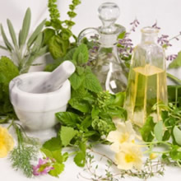
Materials and Methods
FIELD SAMPLING
PRODUCTION OF MEDICINAL PLANTS
Melissa officinalis L. was harvested in July 2016. In all cases the orientation of the plants within each row (North-Center and South) was taking into account during the harvest. The plants were weighed fresh in the field. The mortality of the plants was also recorded
LABORATORY ANALYSIS
PRODUCTION OF MEDICINAL PLANTS
  A subsample of the plants was weighed fresh, dried (36-38ºC) and weighed dry to estimate the dry matter production
  ACTIVE PRINCIPLE
  The leaf concentrations of rosmarinic acid was analysed in Melissa officinalis L.
STATISTICAL ANALYSIS
ANOVA
LSD

Slide 6
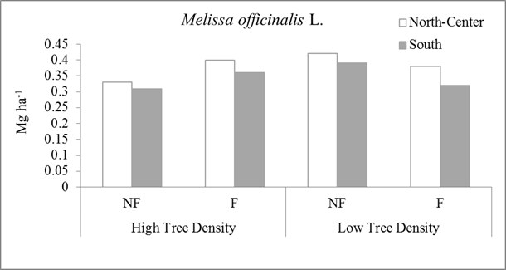
Results Melissa officinalis L. PRODUCTION
The production of Melissa officinalis L. obtained in this study was similar to the production found in other experiments
No significant differences between treatments (Melissa officinalis L. is shade tolerant)

Slide 7
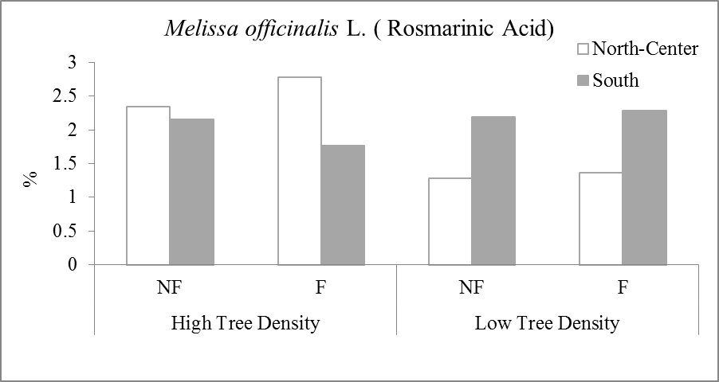
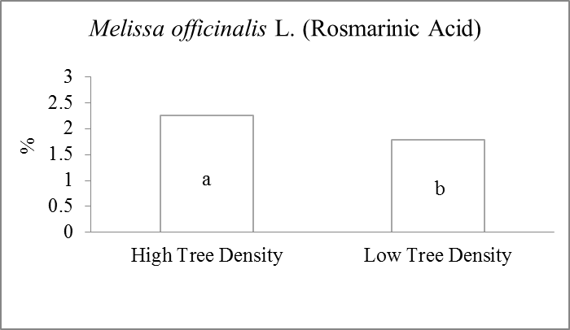
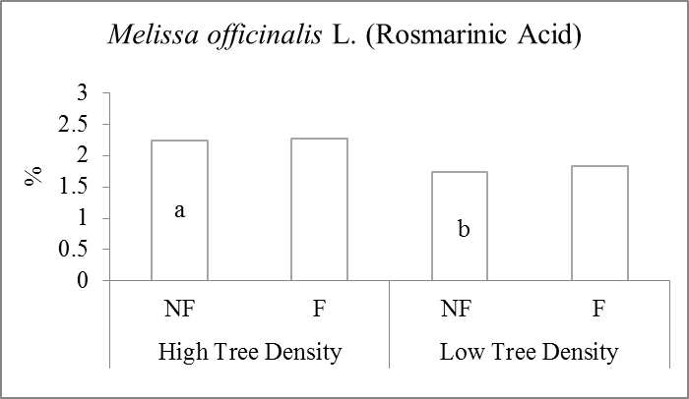
Results
Rosmarinic acid
In this study, rosmarinic acid (1.28-2.78%) was higher than the minimum required by the European Pharmacopoeia (1%)
Rosmarinic acid was higher in high (1333 trees ha⁻¹) compared with low cherry tree density (333 trees ha⁻¹)

Slide 8
Conclusions
No negative effect of the cherry shade was found on Melissa officinalis production, which makes high value tree plantation as an optimum place to combine with medicinal plant production
The higher concentration of rosmarinic acid in Melissa officinalis associated to the high tree density compared with the low tree density could be explained by the delay of the flowering period due to the shade conditions. This result is very important in the farms from a management point of view because the harvest period could be delayed without decreasing the concentration of active principles in medicinal plants such as the Melissa officinalis L. increasing farmer flexibility to harvest

Slide 9

European Union’s Seventh Framework Program for research, technological
development and demonstration under grant agreement no 613520
www.agforward.eu

